Slide 1
Systems research in the AI era
Dushyanth Narayanan
Microsoft Research Future AI Infrastructure (MSR FAI)

Slide 2
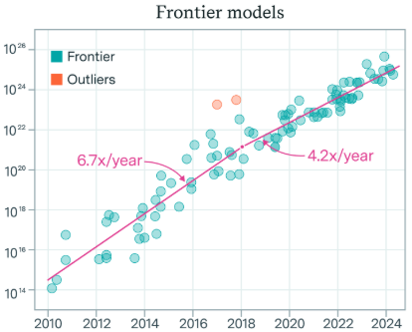
It’s a great time to be a systems researcher
AI is the most important workload
Bigger models → new capabilities
Progress relies on scale
Scale is what we do
Training compute (FLOPs)
Publication year
Training compute of frontier AI models grows by 4-5x per year | Epoch AI

Slide 3

MSR Future AI Infrastructure (FAI)
Systems innovation
Network Compute Memory Storage
ML models
Systems
Efficiency
Network
Compute
Hardware/software codesign
Time
Storage
Memory
Hardware
We are hitting hardware scaling limits
We need research across the stack
And across disciplines
MSR FAI spans MSR labs and disciplines
Partnering with Microsoft product groups and external partners

Slide 4
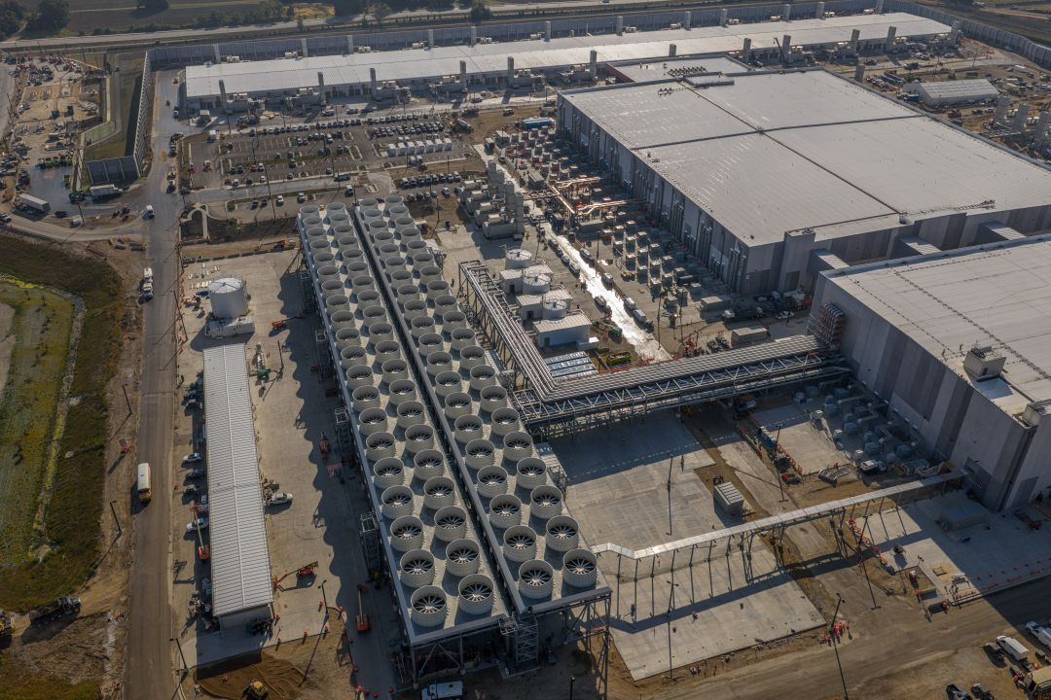

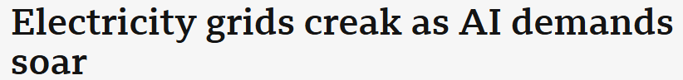

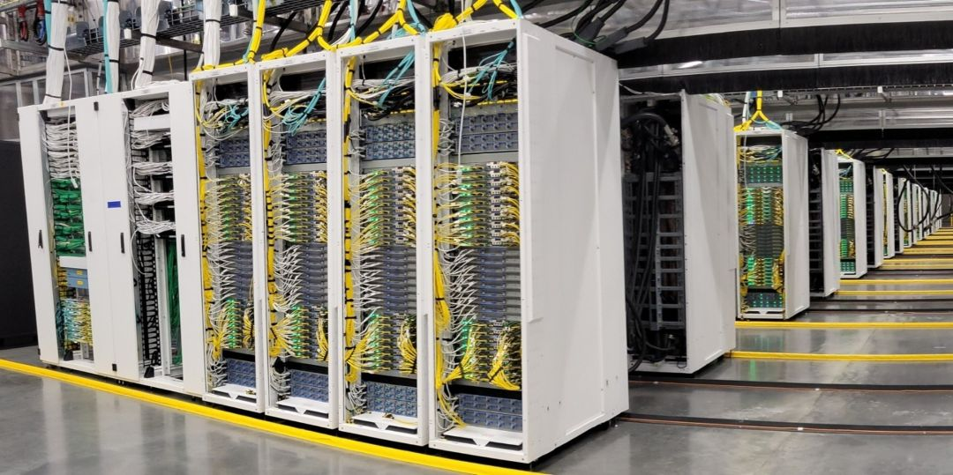
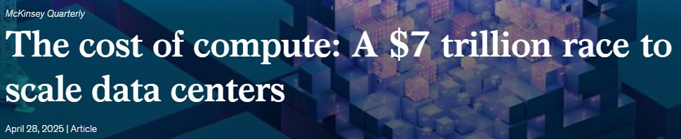
The scale of AI infrastructure is staggering
Inside the world’s most powerful AI datacenter - The Official Microsoft Blog

Slide 5
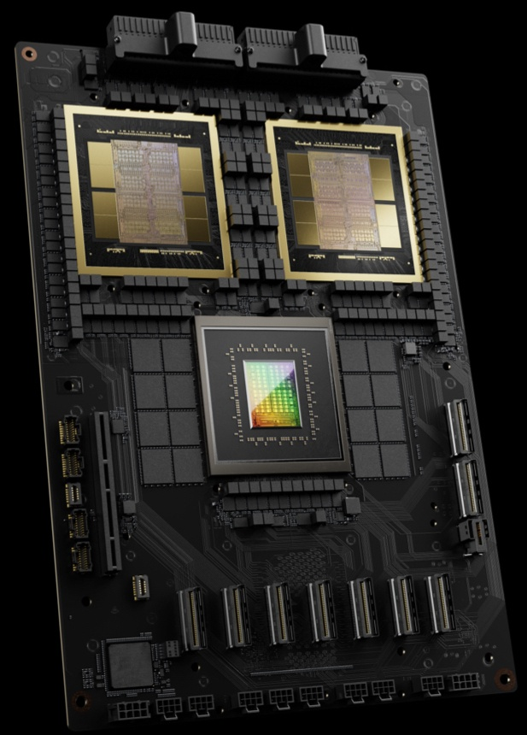
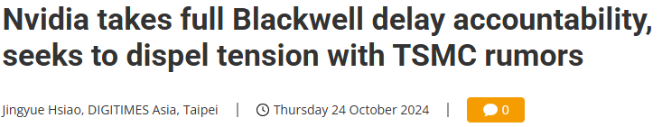
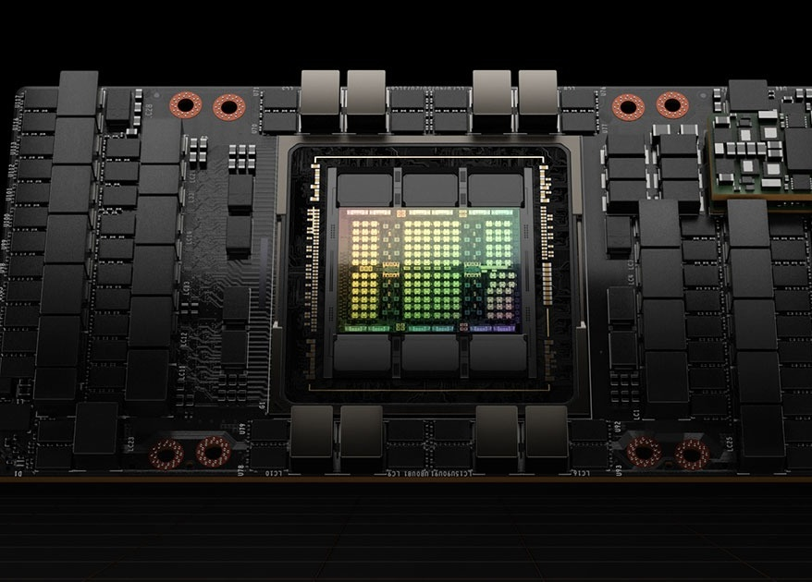
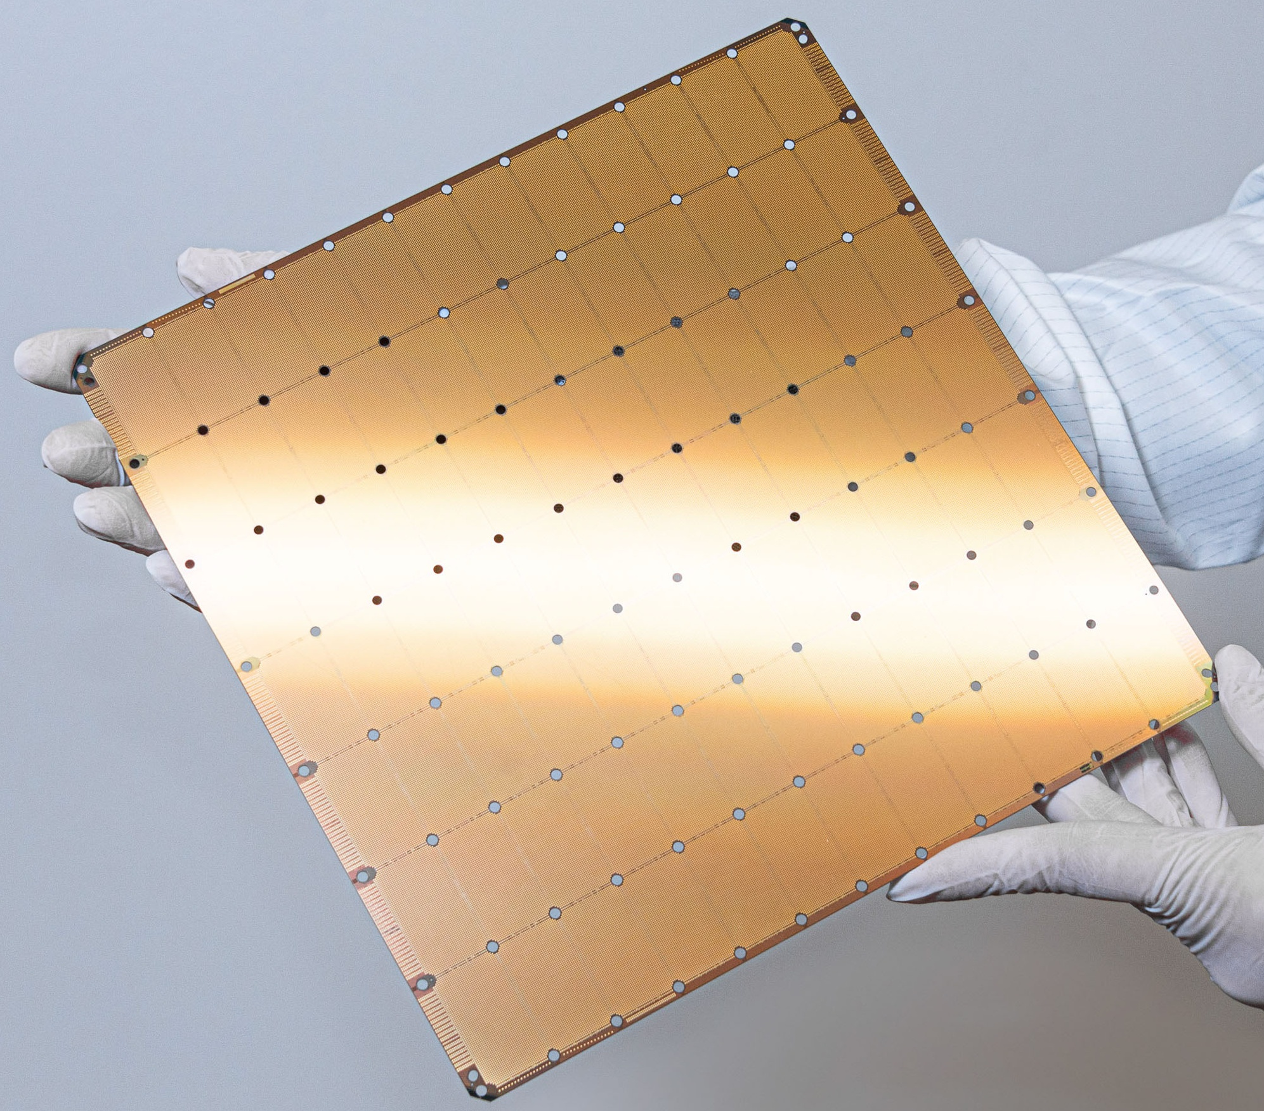

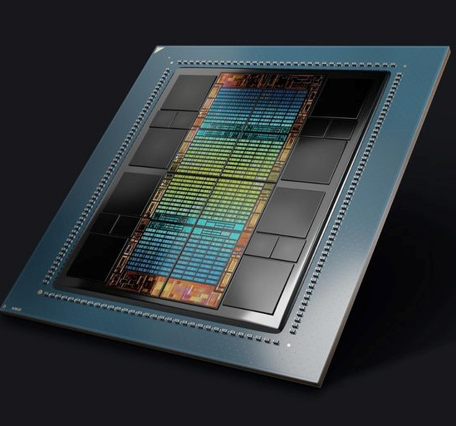
Silicon scaling is hitting limits
Cerebras W3
AMD MI300X
2024
NVIDIA H100 2022
NVIDIA GB200
2025
high manufacturing costs
poor hardware yield
large failure domain
power & heat challenges

Slide 6
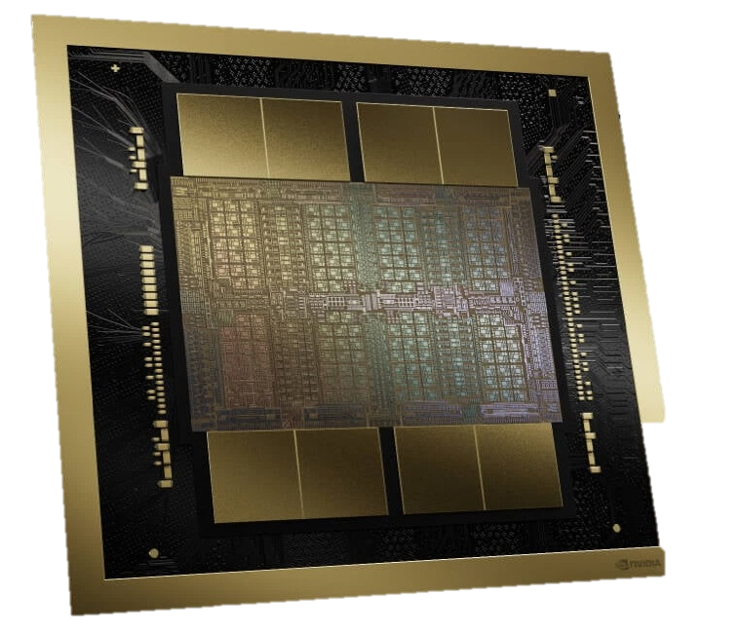
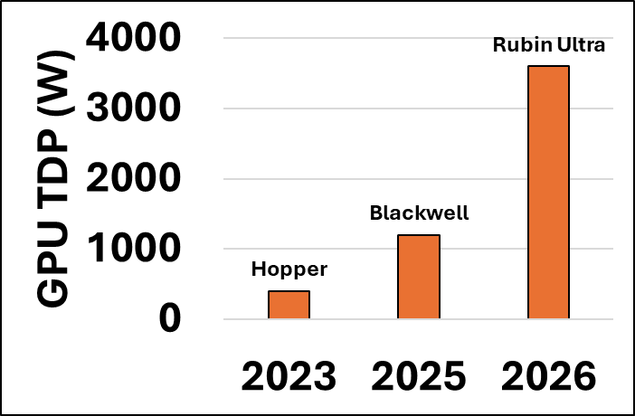
Power and package size are big challenges
Blackwell GPU
8x HBM modules
2x full reticle compute dies
33 mm
26 mm

Slide 7
What is different about AI workloads?
Hardware ultra-specialization
Embarrassingly parallel compute
New systems challenges and opportunities
Very high network bandwidth requirements
Predictable, regular data access
Extreme memory bandwidth requirements

Slide 8
Today’s talk
Scaling clusters without melting the racks
Rethinking memory architectures for AI
Program transformation for specialized hardware

Slide 9
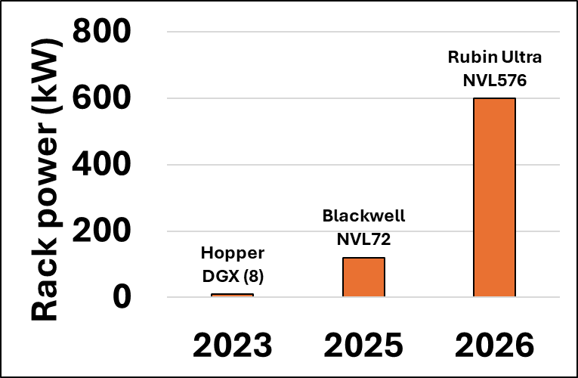
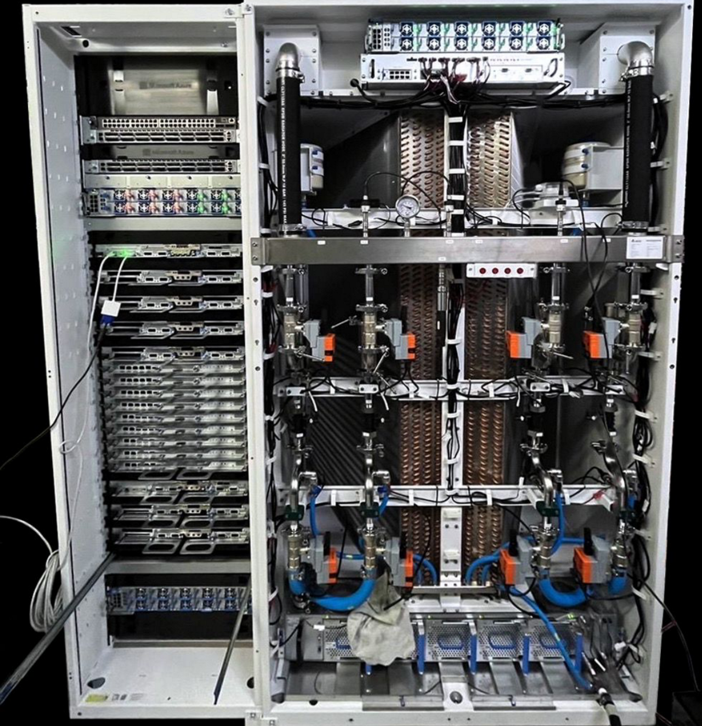
Cluster scaling is hitting power limits
Rack power density keeps growing
Blackwell NVL72
GPUs
Power, cooling, etc.

Slide 10
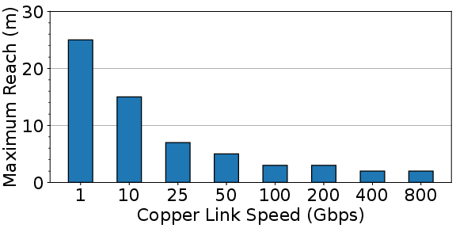
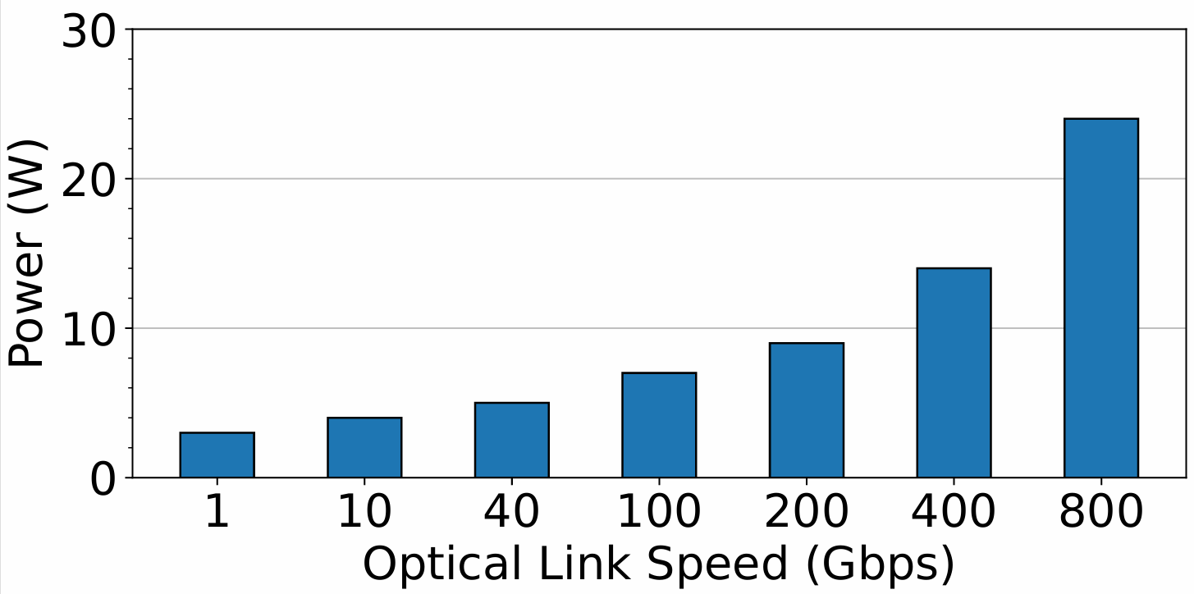
Bandwidth-reach tradeoff
Copper
NVIDIA Blackwell NVL72
Low power, reliable, short reach
NVLink 7.2 Tbps/GPU 72 GPUs
GPU
~10x oversubscription
Ethernet/IB 800 Gbps/GPU
100,000s GPUs
Optics (lasers)
High power, failure-prone, long reach
Can we break this trade-off?

Slide 11

Wide-and-slow to the rescue
…
Many channels operating at low speed (e.g., 800 Gbps = 400 x 2 Gbps)
Few channels operating at high speed (e.g., 800 Gbps = 8 x 100 Gbps)
Commodity technologies
Low power
High reliability
Mosaic: Breaking the Optics versus Copper Trade-off with a Wide-and-Slow Architecture and MicroLEDS

Slide 12
Switches still consume power
Circuit switching: an old idea whose time has come?
Packet switch
Circuit switch
GPU 1
GPU 2
GPU 3
GPU 4
GPU 1
GPU 2
GPU 3
GPU 4
Property | Packet switch Broadcom Tomahawk 5 | Circuit switch Calient S320
Power | 500 W | 45 W
Transceiver power | 900 W | 0 W
Cut through latency | ~600 ns | ~ 0 ns
Port count | 512 | 320
Reconfiguration time | N/A | 100 ms
Challenge: flexibility!

Slide 13
Today’s talk
Scaling clusters without melting the racks
Rethinking memory architectures for AI
Automatic quantization for specialized hardware

Slide 14
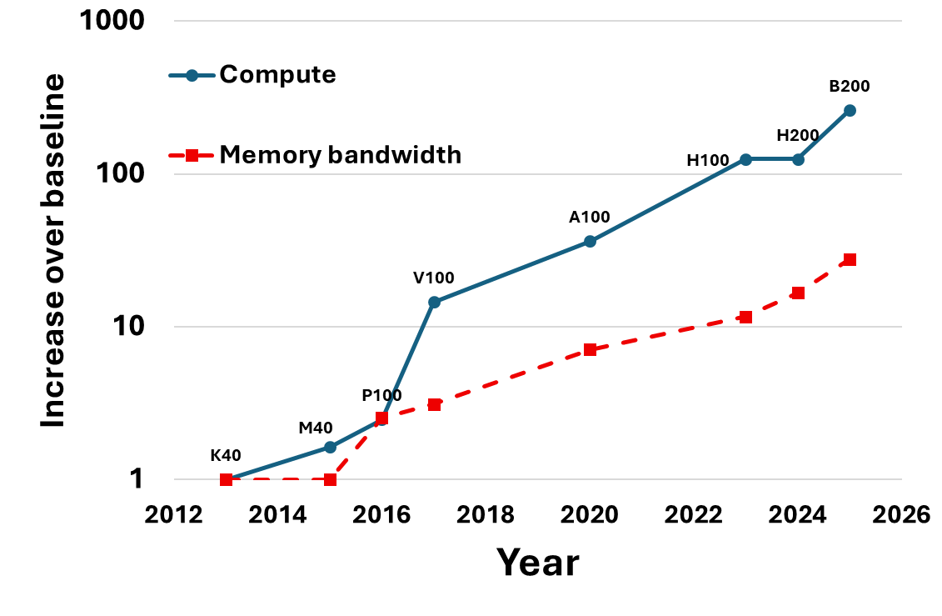
Compute-memory gap is widening
HBM based GPUs
10x
Widened by 10x in 12 years
Despite HBM improvements

Slide 15
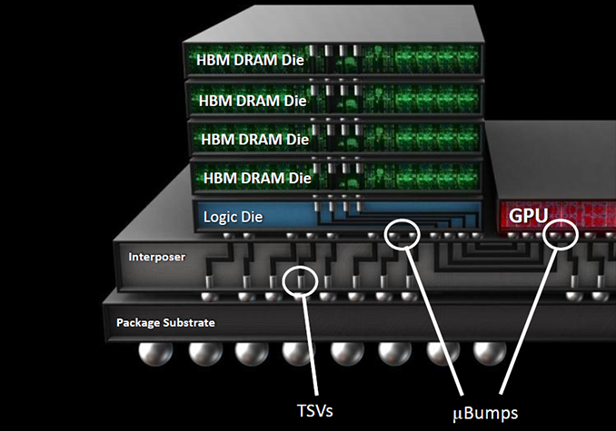
HBM: can’t live with it, can’t live without it
High Bandwidth Memory (HBM) is the only option today to achieve good bandwidth to AI data
Complex manufacturing and packaging
Unreliable
Adds significant cost and power
Still not enough bandwidth!
Plotting The Next Semiconductor Road Map

Slide 16
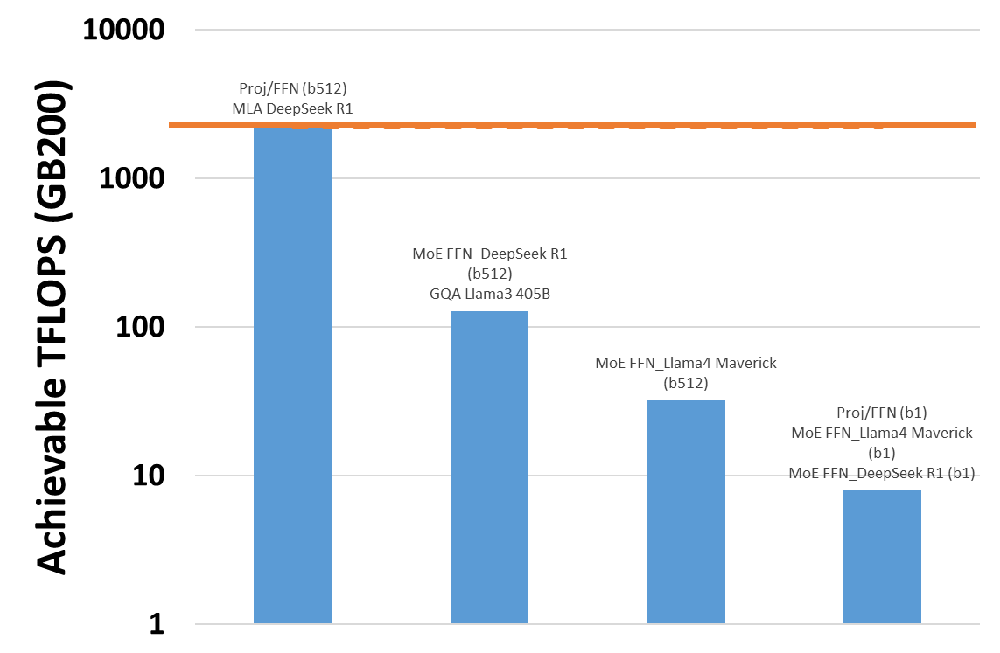
Many operations are memory bound
Prefill Training
This is getting worse
Long contexts
Agentic workloads
Multimodal models
Compute utilization < 0.5%

Slide 17
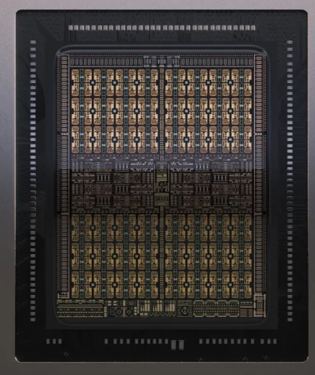
Specialization for compute is happening
NVIDIA Rubin CPX
Workloads will become more memory-bound overall
Amdahl’s Law
We also need to specialize for bandwidth
No HBM
4x FP4 FLOPS of B200
0.5x memory bandwidth
NVIDIA Rubin CPX Accelerates Inference Performance and Efficiency for 1M+ Token Context Workloads | NVIDIA Technical Blog
Another Giant Leap: The Rubin CPX Specialized Accelerator & Rack

Slide 18
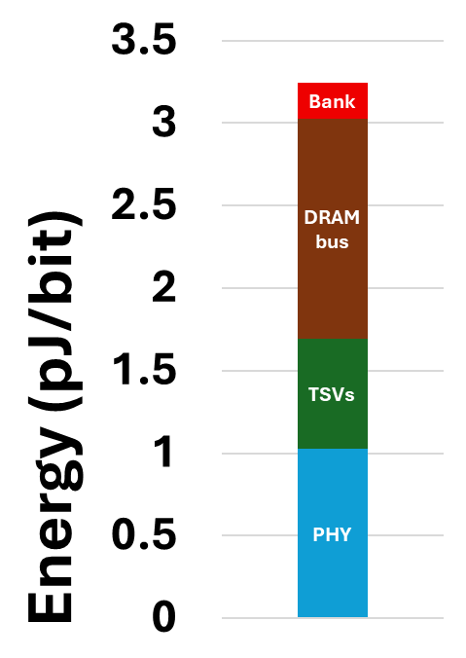
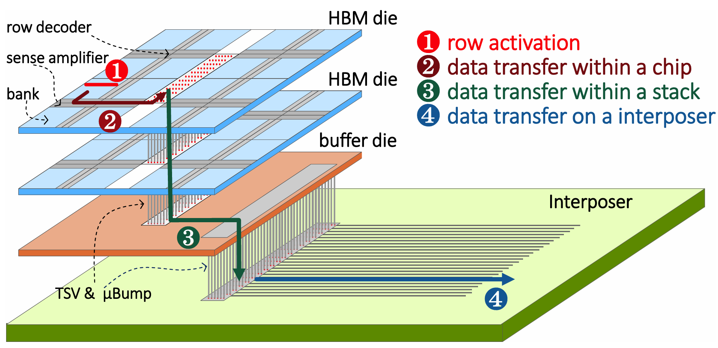
The challenge is data movement not access
Architecting an Energy-Efficient DRAM System for GPUs Chatterjee et al, ISCA 2017
Data movement dominates energy
Energy limits bandwidth
HBM3e (our model)

Slide 19
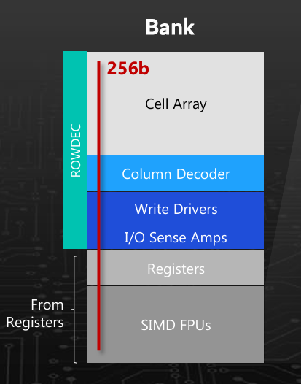
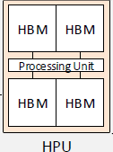
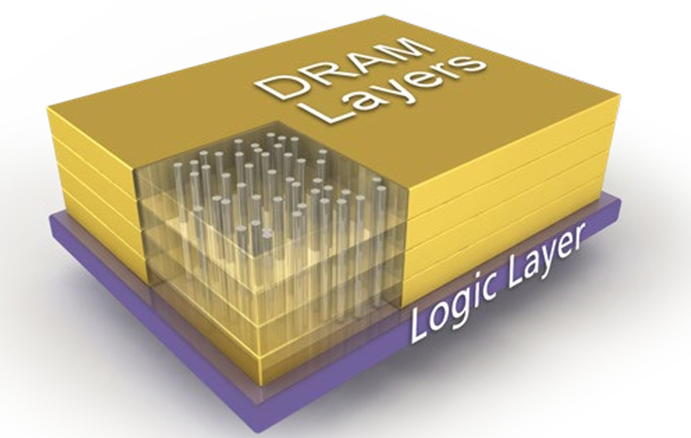
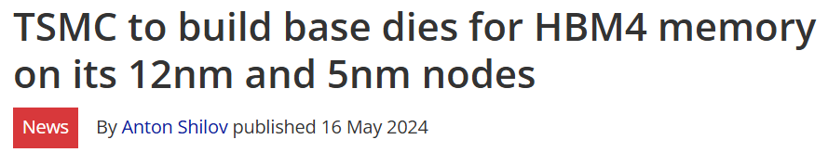
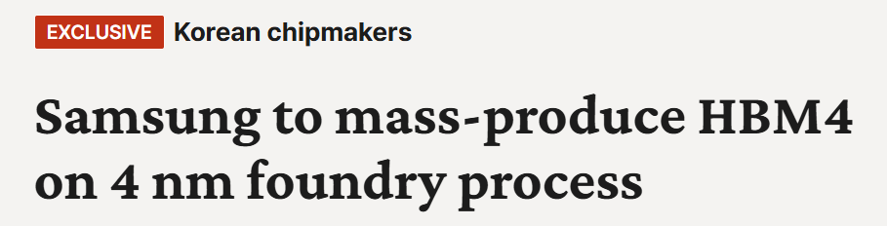
Re-emergence of PIM (Program in Memory)
Compute on DRAM die
☺ Very close to memory
☹ DRAM die is poor fit for compute
Wimpy compute die
☺ Unchanged HBM + packaging
☹ Unchanged HBM + packaging
Aquabolt-XL: Samsung HBM2-PIM with in-memory processing for ML accelerators and beyond (Hotchips 2021)
[2504.16112] HPU: High-Bandwidth Processing Unit for Scalable, Cost-effective LLM Inference via GPU Co-processing
Compute on base die
HBM3 does not support logic layer
HBM4 will support it!
Hybrid memory cube (HMC) (HotChips 2011)

Slide 20
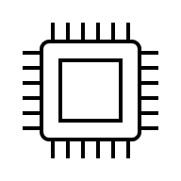
Example: PIM for decode attention
What does the interconnect look like?
Can we use circuit switching?
Latency and packet drops
Fault tolerance
Can we automate the partitioning?
Are there other use cases?
Collective
Collective
Compute optimized
Bandwidth optimized

Slide 21
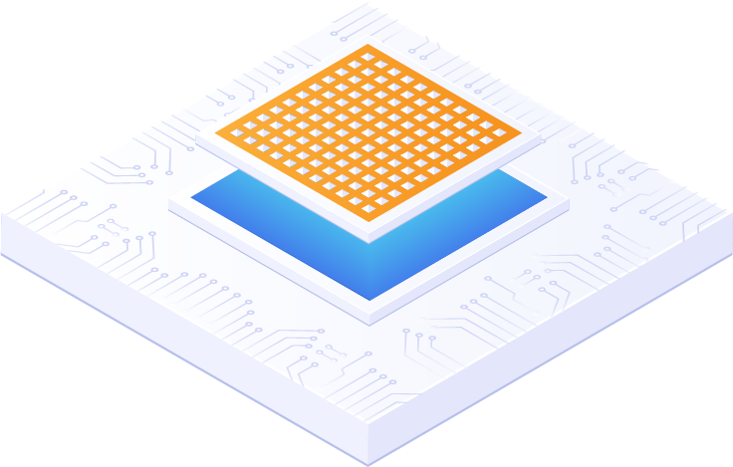
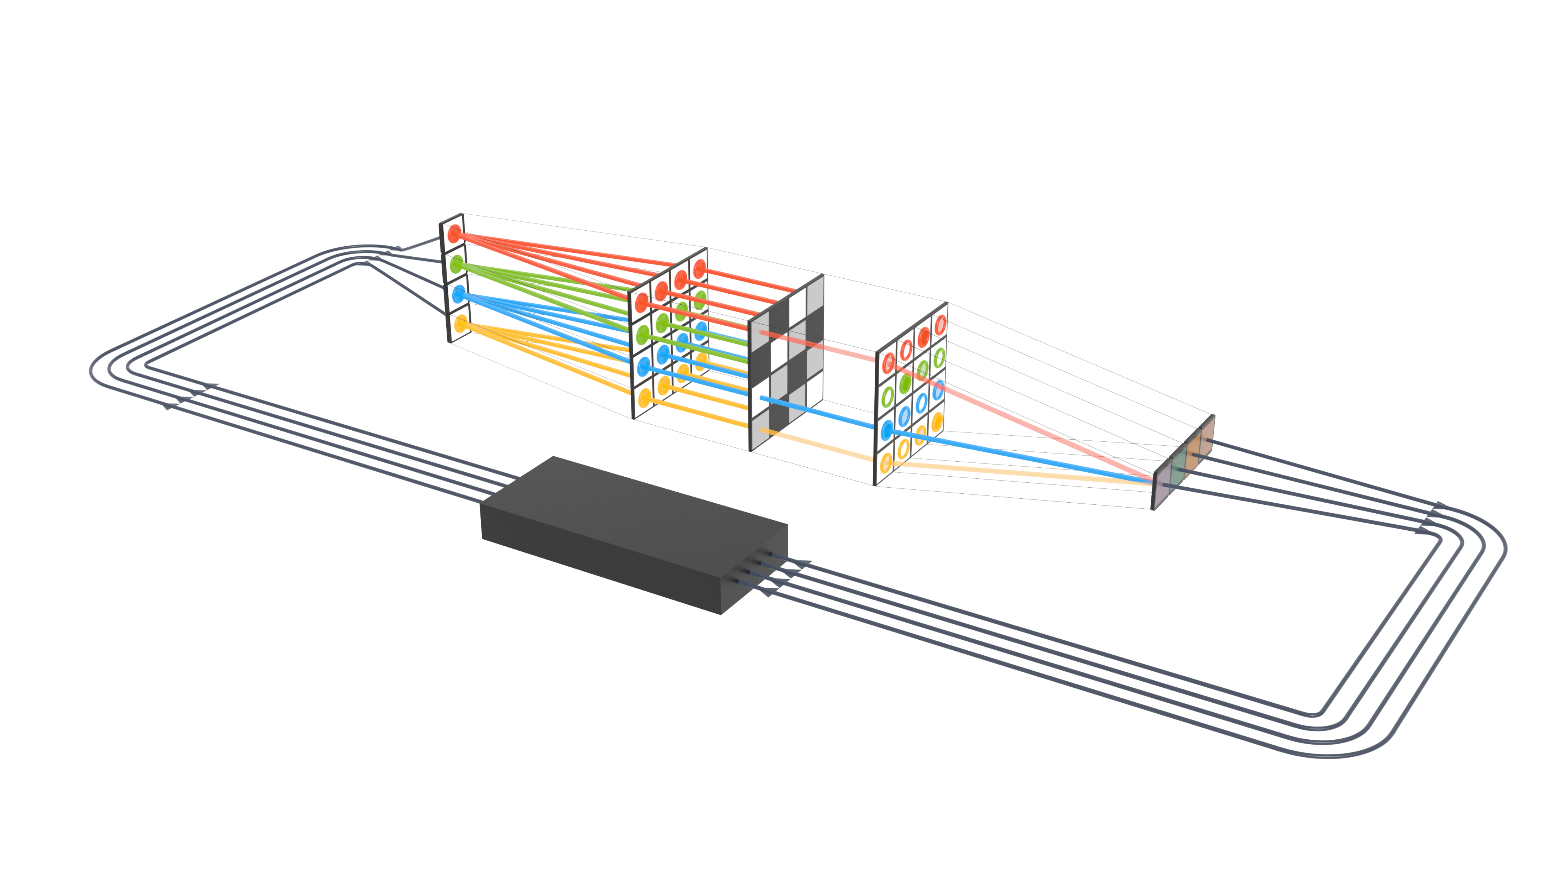
The future is heterogenous and disaggregated
Compute optimized
Specialized hardware
Scalable networking
Packet
switch
Circuit switch
Bandwidth optimized
Compute optimized
3D stacked optics
Ultra high bandwidth optics
New memory technologies
New compute
architectures
Circuit switch
Bandwidth optimized
Analog/optical computing

Slide 22
Today’s talk
Scaling clusters without melting the racks
Rethinking memory architectures for AI
Program transformation for specialized hardware

Slide 23
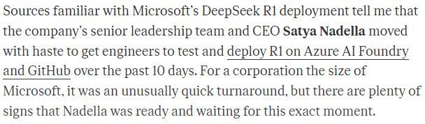
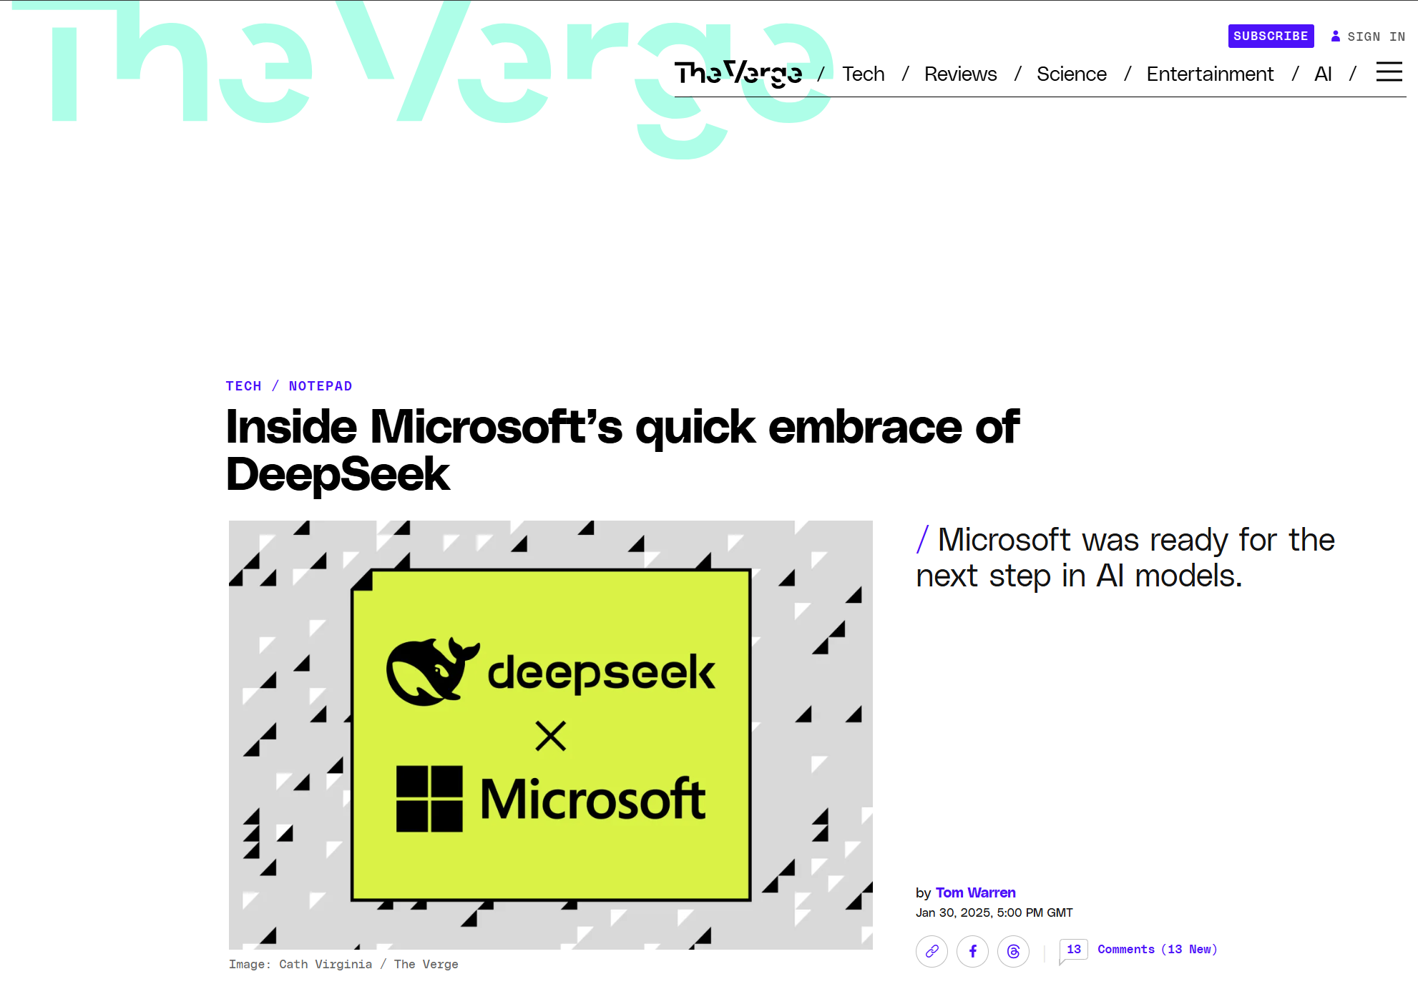
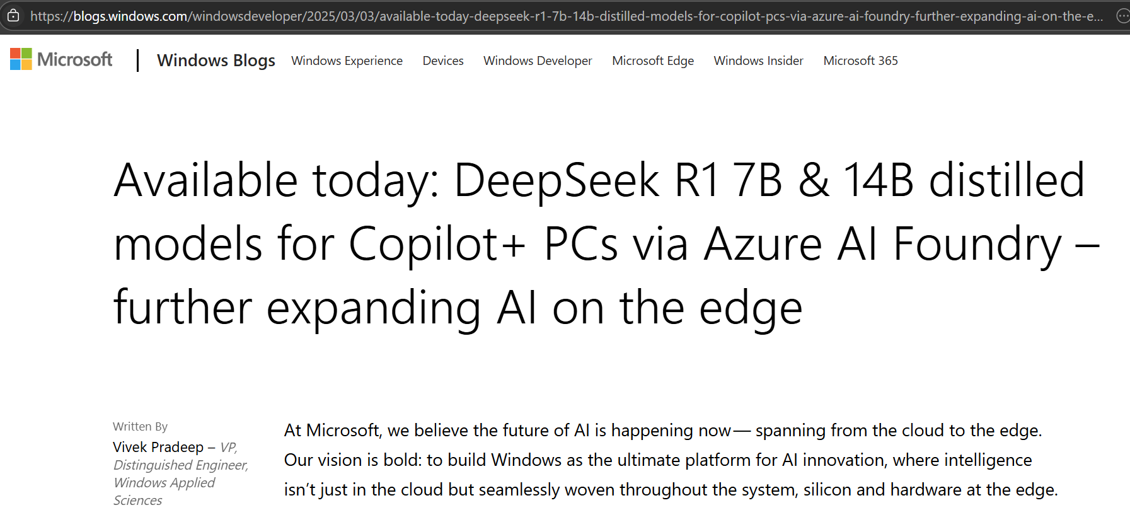
Multiple ways to improve AI efficiency
Lower $
Lower W
Higher Velocity

Slide 24
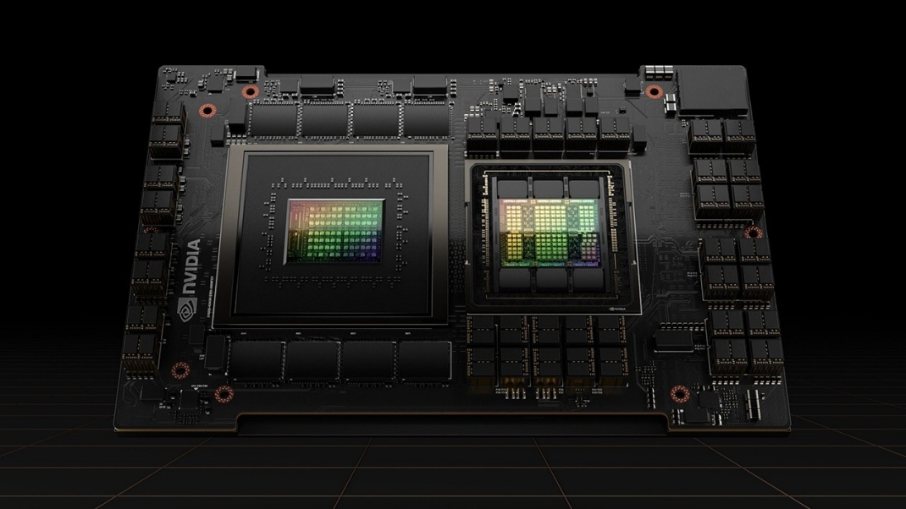

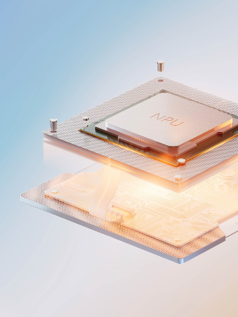
Quantizing models for NPU
GPU
96 GB HBM
fp16
NPU
16 GB LPDDR
int4

Slide 25
Quantization workflow
QuaRot: SOTA quantization technique
Quantized model for NPU
New model released for GPU
Compute rotation tensors using calibration dataset
Validate perf and accuracy
Insert new ops into source code
Complex and time consuming!

Slide 26
Model rotation as program synthesis problem
Many equivalent operator graphs
(Un)rotation
Operator fusion
Reordering
With constraints
Matmul inputs are quantized
Quantization op inputs are rotated
…
Minimize graph execution cost
X
W
X
W @ Q
Op
Op
Q
Rotate
Quantize
Quantize

Slide 27
Aqua compiler
Frontend
PyTorch
Module
Aten
graph
Solver
satisfies:
peak memory below limit
latency is minimal
Constraints
data flow
rotation
fusion
cost
Tensor schedule
rotation
quantization
unrotation
Backend
Graph
rewriter
Quant’d
module

Slide 28
New opportunities for PL techniques
Traditional program analysis
Loops
Data structures
Aliasing
Concurrency
AI program analysis
Tensor computation / linear algebra
Data parallel hardware
Collectives
Global optimization

Slide 29
We’ve just started exploring
Mosaic: Breaking the Optics versus Copper Trade-off with a Wide-and-Slow Architecture and MicroLEDS (SIGCOMM 2025 best paper)
Storage Class Memory is Dead, All Hail Managed-Retention Memory: Rethinking Memory for the AI Era (HotOS ‘25)
Good things come in small packages: Should we build AI clusters with Lite-GPUs? (HotOS ‘ 25)
Towards Memory Specialization: A Case for Long-Term and Short-Term RAM (DIMES ‘25)
Analog optical computer for AI inference and combinatorial optimization | Nature

Slide 30
Efficiency and scalability are crucial for AI
Systems innovation
ML models
Systems
Network Compute Memory Storage
Efficiency
Network
Compute
Hardware/software codesign
Time
Storage
Memory
Hardware
We are hitting hardware scaling limits
And across disciplines
We need research across the stack

